Slide 1


Slide 2


Slide 3


Slide 4
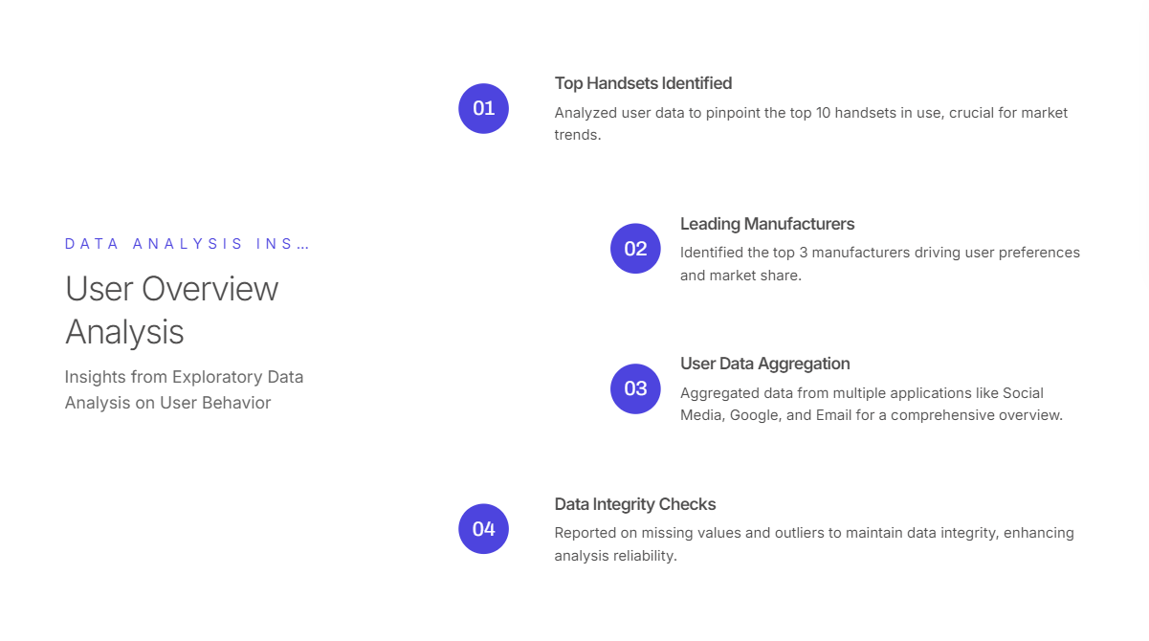

Slide 5
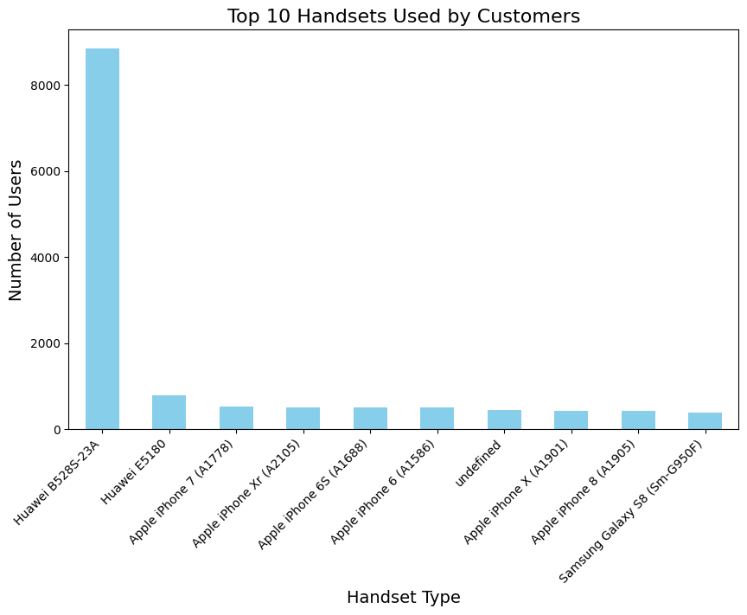
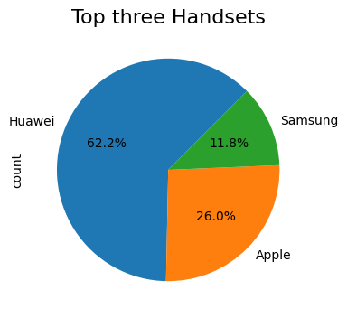
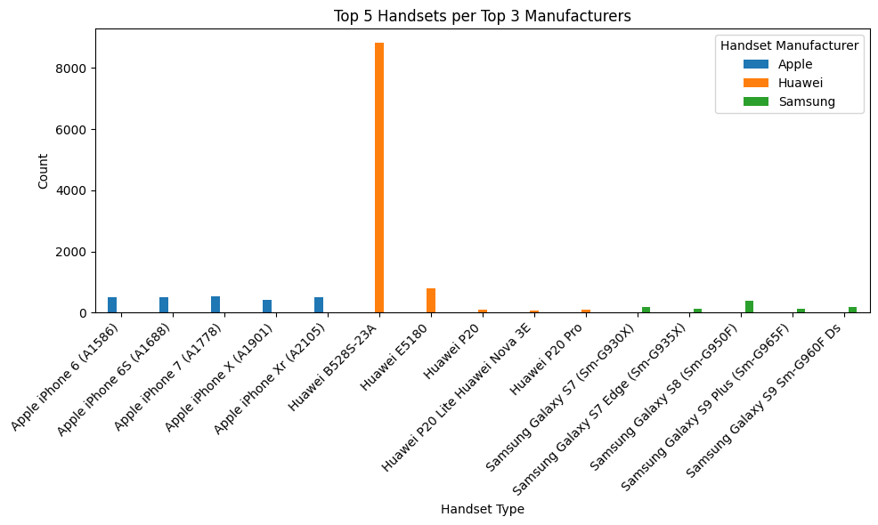

Slide 6
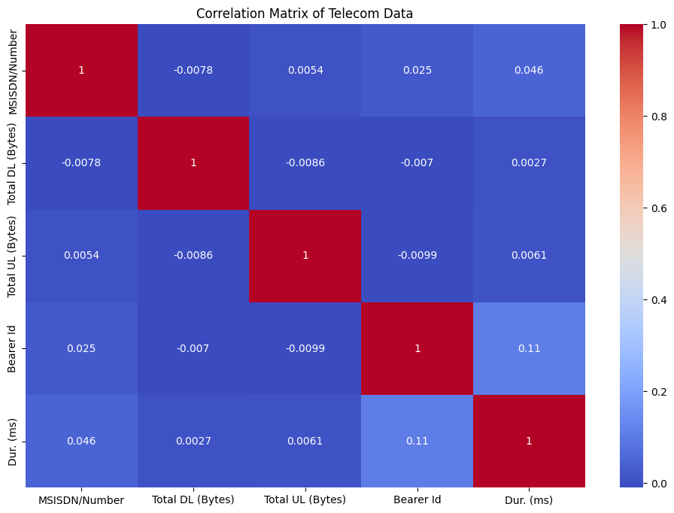
Minimal Correlations: There is also a correlation matrix that shows there are no strong correlations between the variables in this dataset.
Weakly Positive Correlation: There is a weak positively correlation between Bearer Id and Dur (ms). This means simply, sessions in which Bearer Id values are high have higher durations.
No Correlations: All other variables have no correlation to each potential with each other so they are basically independent.

Slide 7
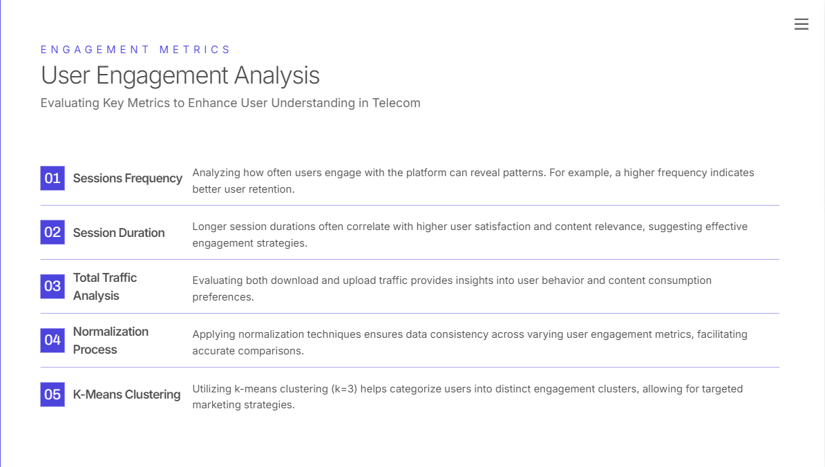

Slide 8
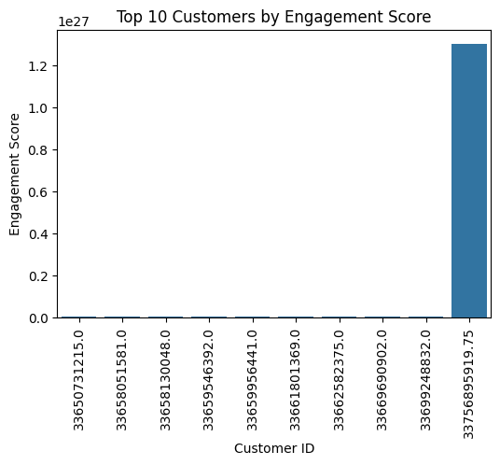
Top 10 customers per engagement metric

Slide 9


Slide 10
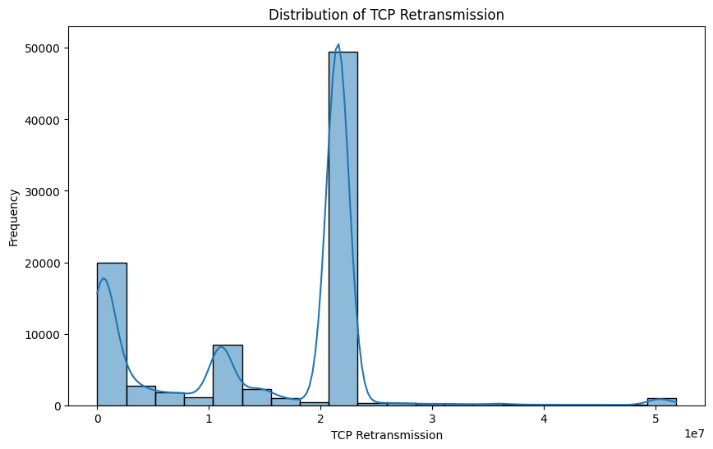
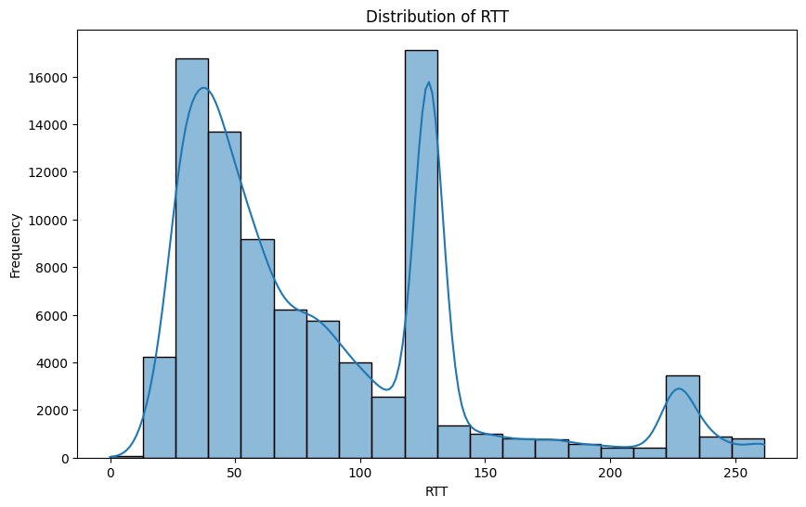
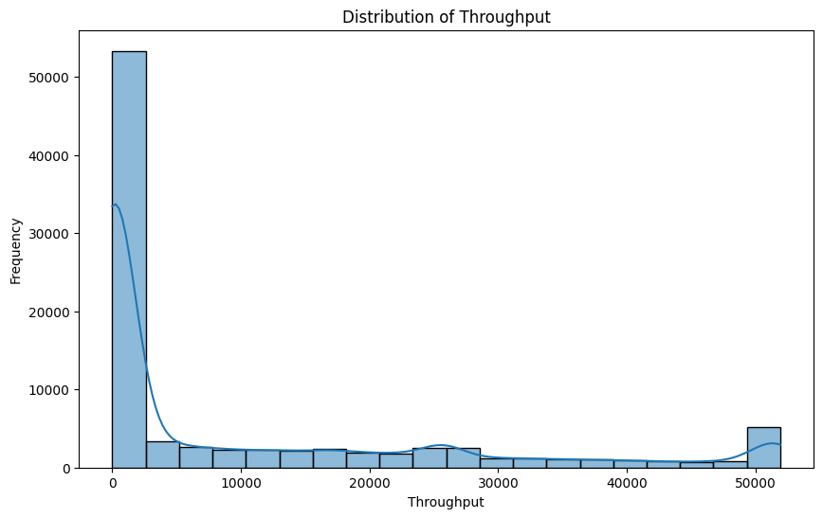

Slide 11


Slide 12


Slide 13


Slide 14


